Slide 1
GENETIC ALGORITHM

Slide 2
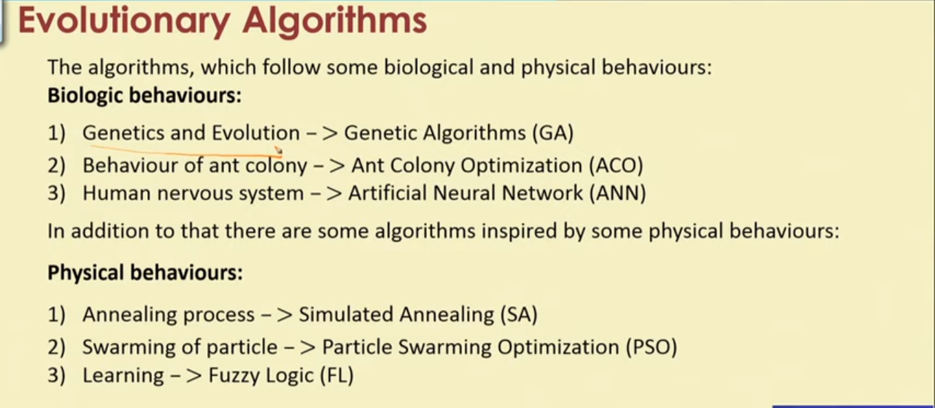

Slide 3
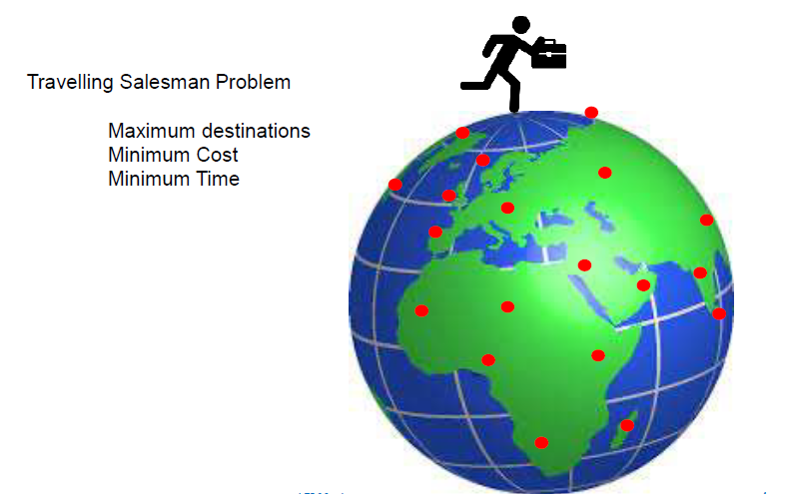
Why Genetic Algorithm

Slide 4
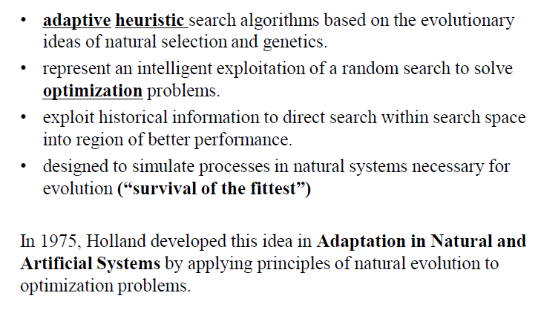
What are Genetic Algorithms (GAs)?

Slide 5


Slide 6
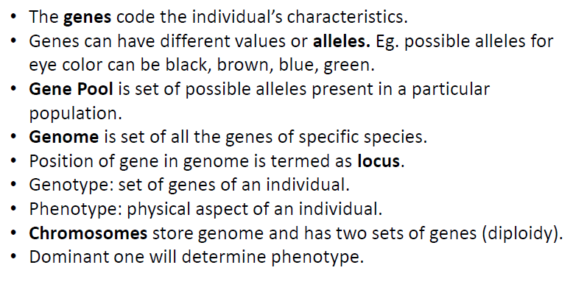
Understanding biological terminologies

Slide 7
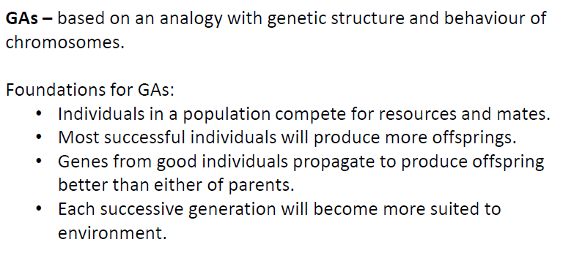
Terminologies in GAs

Slide 8
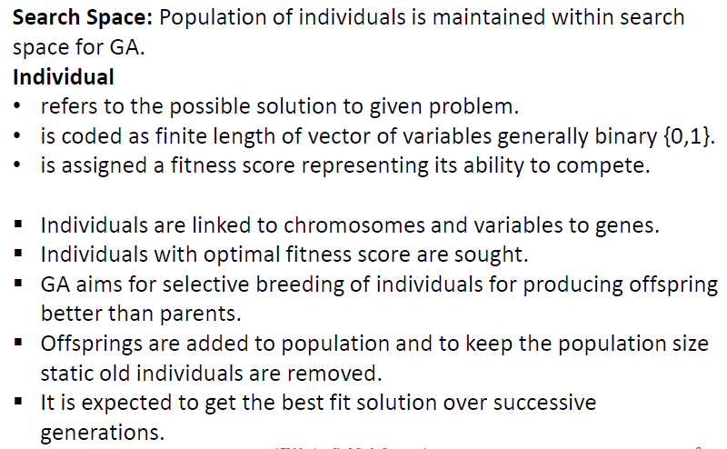
Terminologies in GAs

Slide 9
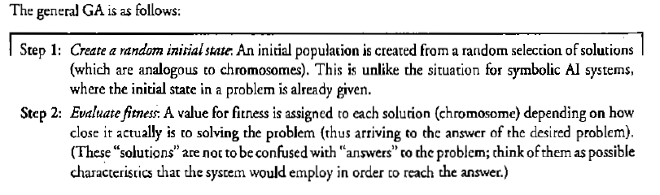
Simple Genetic Algorithm

Slide 10
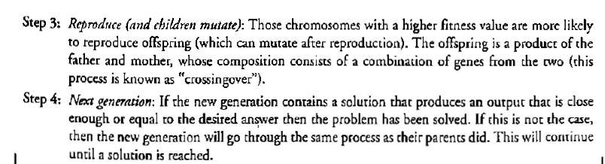
Simple Genetic Algorithm

Slide 11
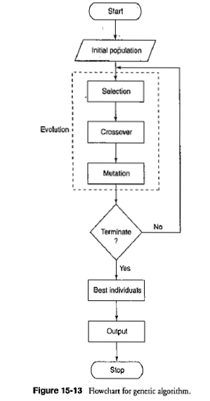

Slide 12
Main features of Genetic Algorithms (GA)
Genetic Algorithms (GA) use principles of natural evolution. There are five important features of GA:
Fitness Function represents the main requirements of the desired solution of a problem (i.e. cheapest price, shortest route, most compact arrangement, etc). This function calculates and returns the fitness of an individual solution.
Encoding possible solutions of a problem are considered as individuals in a population. If the solutions can be divided into a series of small steps (building blocks), then these steps are represented by genes and a series of genes (a chromosome) will encode the whole solution. This way different solutions of a problem are represented in GA as chromosomes of individuals.

Slide 13
Main features of Genetic Algorithms (GA)
3. Selection operator defines the way individuals in the current population are selected for reproduction. There are many strategies for that (e.g. roulette–wheel, ranked, tournament selection, etc), but usually the individuals which are more fit are selected.
4. Crossover operator defines how chromosomes of parents are mixed in order to obtain genetic codes of their offspring (e.g. one–point, two–point, uniform crossover, etc). This operator implements the inheritance property (offspring inherit genes of their parents)

Slide 14
Main features of Genetic Algorithms (GA)
5. Mutation operator creates random changes in genetic codes of the off- spring. This operator is needed to bring some random diversity into the genetic code. In some cases GA cannot find the optimal solution without mutation operator (local maximum problem)

Slide 15
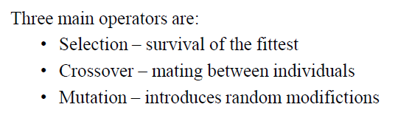
Operators in GA

Slide 16
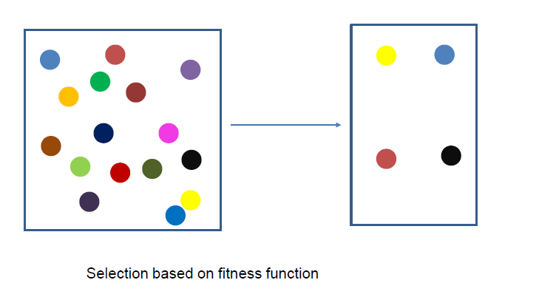
Selection Operator

Slide 17
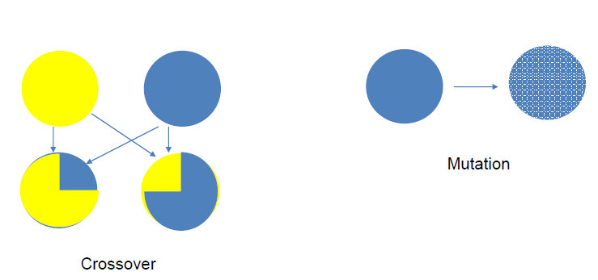
Crossover and Mutation Operator

Slide 18
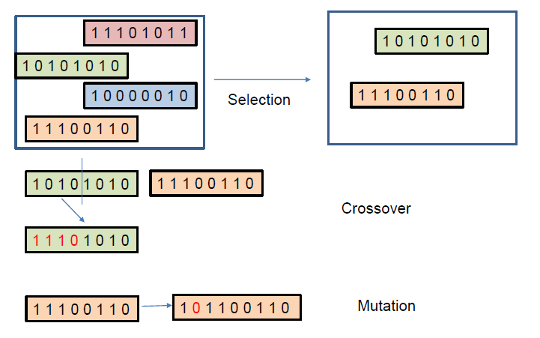
Operators in GA

Slide 19
Types of Crossover Schemes
Single Point Crossover
Two Point Crossover
Multi-point crossover
Uniform Crossover
Shuffle Crossover

Slide 20
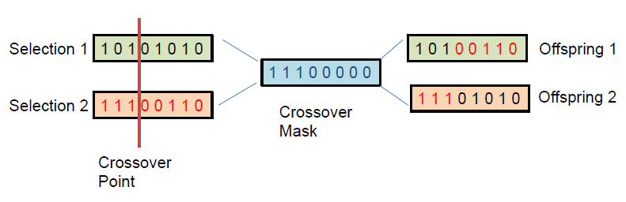
Single Point Crossover

Slide 21
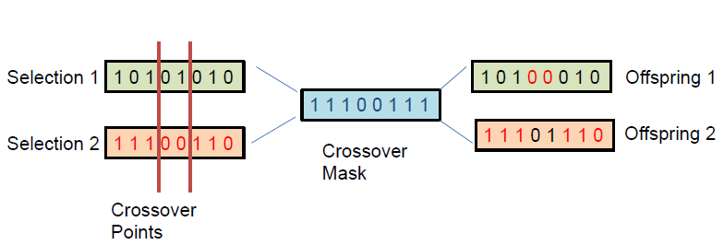
Two Point Crossover

Slide 22
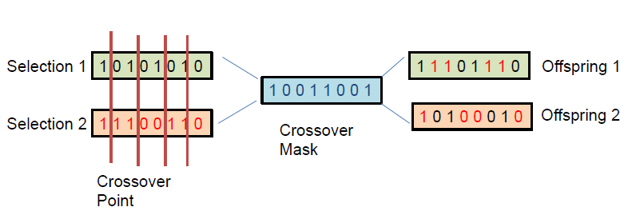
Multi-point Crossover

Slide 23
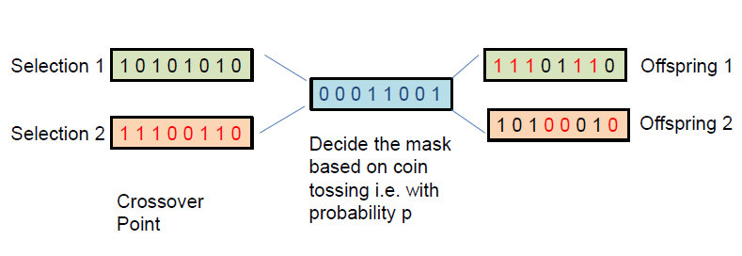
Uniform Crossover

Slide 24
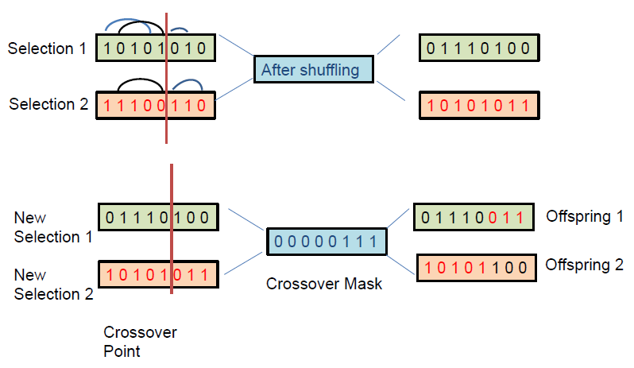
Shuffle Crossover

Slide 25
Numerical 1
Question: Consider the problem of finding the shortest route through several cities, such that each city is visited only once and in the end return to the starting city (the Travelling Salesman problem). Suppose that in order to solve this problem we use a genetic algorithm, in which genes represent links between pairs of cities. For example, a link between London and Paris is represented by a single gene ‘LP ’. Let also assume that the direction in which we travel is not important, so that LP =P L

Slide 26
Numerical 1 (contd.)
(a) How many genes will be used in a chromosome of each individual if the number of cities is 10?
Answer: Each chromosome will consist of 10 genes. Each gene representing the path between a pair of cities in the tour

Slide 27
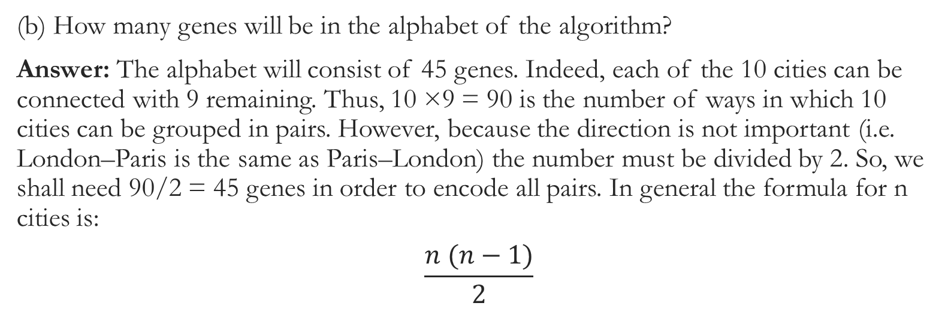
Numerical 1 (contd.)
(b) How many genes will be in the alphabet of the algorithm?
Answer: The alphabet will consist of 45 genes. Indeed, each of the 10 cities can be connected with 9 remaining. Thus, 10 ×9 = 90 is the number of ways in which 10 cities can be grouped in pairs. However, because the direction is not important (i.e. London–Paris is the same as Paris–London) the number must be divided by 2. So, we shall need 90/2 = 45 genes in order to encode all pairs. In general the formula for n cities is:
$$\frac{n (n−1)}{2}$$

Slide 28

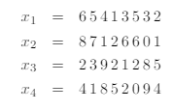
Numerical 2
Question: Suppose a genetic algorithm uses chromosomes of the form x=abcdefgh with a fixed length of eight genes. Each gene can be any digit between 0 and 9. Let the fitness of individual xbe calculated as
and let the initial population consist of four individuals with the following chromosomes

Slide 29
Numerical 2 (contd.)
(a) Evaluate the fitness of each individual, showing all your workings, and arrange them in order with the fittest first and the least fit last.
(b) Perform the following crossover operations:
i) Cross the fittest two individuals using one–point crossover at the middle point.
ii) Cross the second and third fittest individuals using a two–point crossover (points band f)
iii) Cross the first and third fittest individuals (ranked 1st and 3rd) using a uniform crossover

Slide 30
Numerical 2 (contd.)
(c) Suppose the new population consists of the six offspring individuals received by the crossover operations in the above question. Evaluate the fitness of the new population, showing all your workings. Has the overall fitness improved?
(d) By looking at the fitness function and considering that genes can only be digits between 0 and 9 find the chromosome representing the optimal solution (i.e. with the maximum fitness). Find the value of the maximum fitness

Slide 31
Numerical 2 (contd.)
(e) By looking at the initial population of the algorithm can you say whether it will be able to reach the optimal solution without the mutation operator?
Answer: No, the algorithm will never reach the optimal solution without mutation. The optimal solution is x optimal = 99009900. If mutation does not occur, then the only way to change genes is by applying the crossover operator. Regardless of the way crossover is performed, its only outcome is an exchange of genes of parents at certain positions in the chromosome. This means that the first gene in the chromosomes of children can only be either 6, 8, 2 or 4 (i.e. first genes of x1,x2,x3 and x4), and because none of the individuals in the initial population begins with gene 9, the crossover operator alone will never be able to produce an offspring with gene 9 in the beginning. One can easily check that a similar problem is present at several other positions. Thus, without mutation, this GA will not be able to reach the optimal solution.

